Slide 1
DELTA MODULATION

Slide 2
DELTA MODULATION
Advantage of DM:
Reduced bit rate
Simplified design of modulator and demodulator.
Disadvantage:
Quality is less

Slide 3
DELTA MODULATION
DM is a variant of DPCM
Over-sampling is used to exploit the correlation feature of the speech signal once again.

Slide 4
Motivation for DM
In DPCM exploited the correlation feature of the speech signal at τ=125μs sampling interval
Correlation value was high between 0.79-0.87
This value was nicely utilizes in design of the predictor.
In DM we are going to utilizes this correlation feature even more than that.
We could have larger value of this correlation coefficient.

Slide 5
Why we go for over sampling?
To simplify the design of DM modulator and demodulator.

Slide 6
DM
Correlation feature used in DPCM is further exploited in DM
By oversampling (typically 4 times the Nyquist rate) the baseband signal.
This increases the correlation between adjacent samples,
Which results in a small prediction error that can be encoded using only one bit (L=2).

Slide 7
DM
Thus, DM is a 1-bit DPCM
i.e. a DPCM that uses only 2 levels (L=2) for quantization of the x(kTs)-x^(kTs).
In comparison to PCM and DPCM,
DM is very simple and inexpensive method of A/D conversion.
This strategy allows us to use fewer bits per sample for encoding a baseband signal.

Slide 8
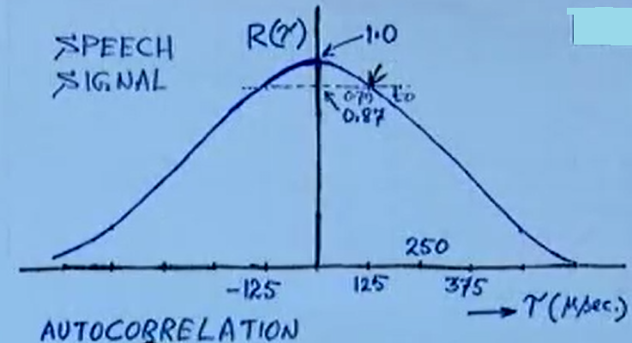

Slide 9
Motivation for DM
Due to over sampling move inwards towards 1.
Increasing sampling rate , decreases τ value.
Then corresponding correlation coefficient value will be increasing from 0.87 to 0.9 or 0.95.
Because of over sampling, two closely spaced samples are very similar to each other.
With this prime motivation DMr & demodulator have been designed.

Slide 10
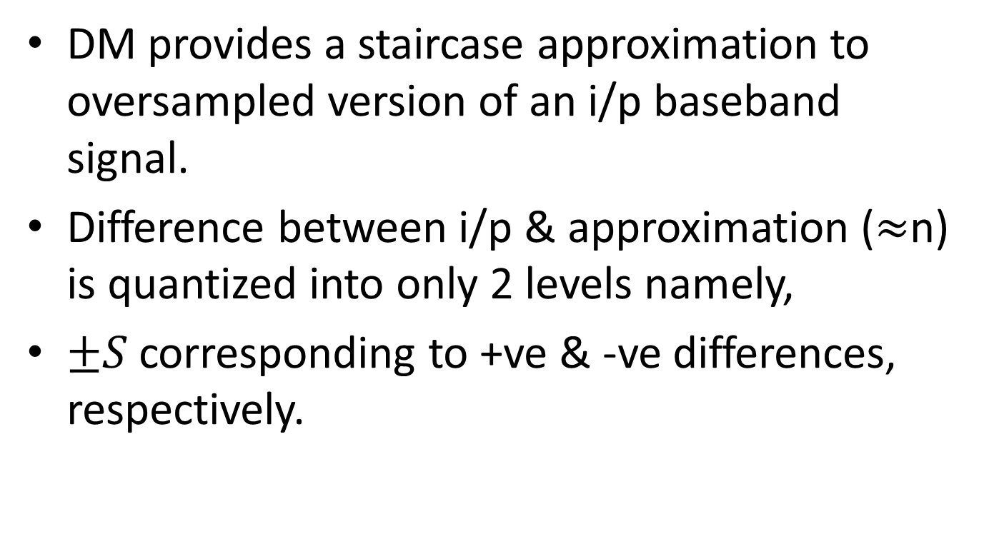
DM
DM provides a staircase approximation to oversampled version of an i/p baseband signal.
Difference between i/p & approximation ($≈$n) is quantized into only 2 levels namely,
$±S$corresponding to +ve & -ve differences, respectively.

Slide 11
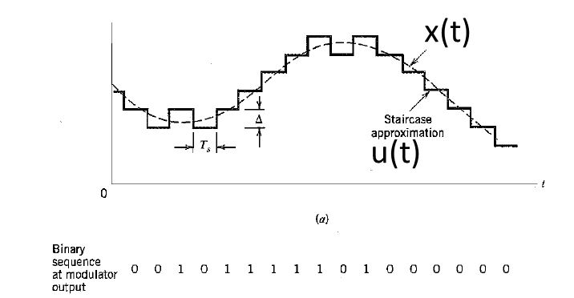
Illustration of DM

Slide 12
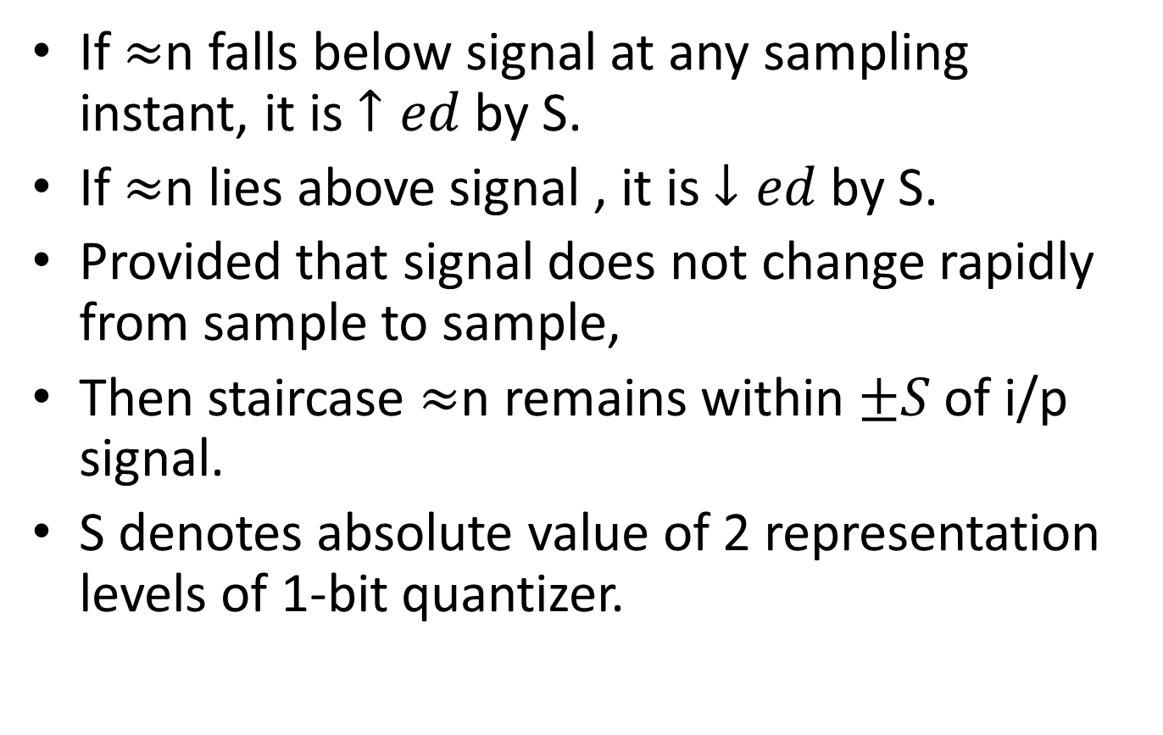
DM
If $≈$n falls below signal at any sampling instant, it is $↑ed$by S.
If $≈$n lies above signal , it is $↓ed$by S.
Provided that signal does not change rapidly from sample to sample,
Then staircase $≈$n remains within $±S$ of i/p signal.
S denotes absolute value of 2 representation levels of 1-bit quantizer.

Slide 13
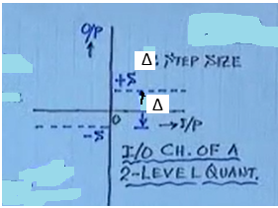
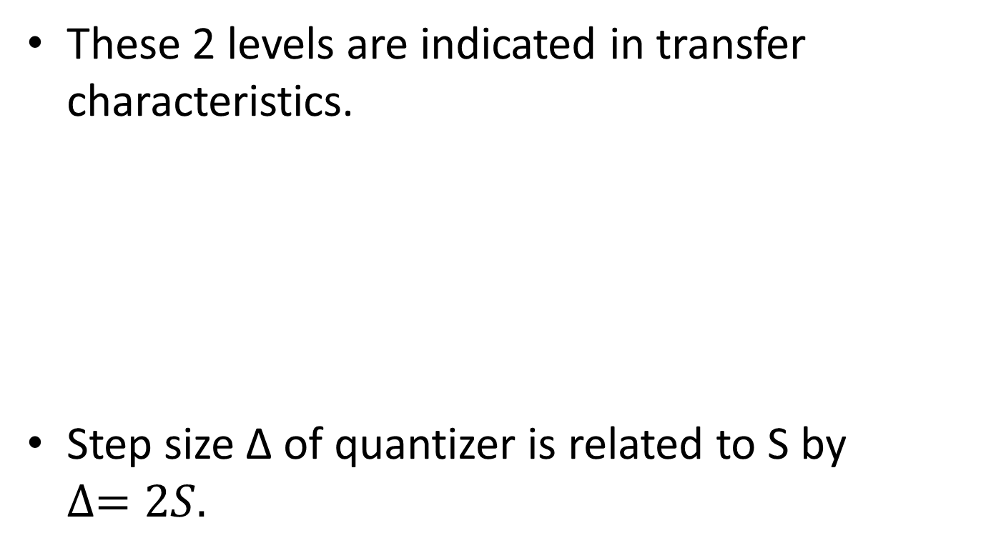
I/P-O/P characteristics of 2 level Quantizer
These 2 levels are indicated in transfer characteristics.
Step size Δ of quantizer is related to S by $∆=2S.$

Slide 14
DM
Results in stair case approximation of input signal at quantizer output.
Stair size or step size should be small.
Hence this modulation is called Delta modulation.
Step size is always Δ.

Slide 15
Characteristics of Quantizer
Quantizer input may be +ve or –ve, hence quantizer output is at fixed value +S and –S.
Irrespective of amplitude of i/p signal quantizer output is +S or –S.

Slide 16
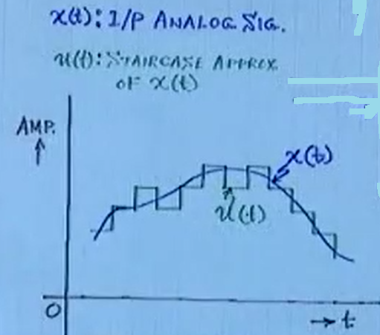
Input signal and its stair case approximaion
Stair case approximation means signal will vary in certain steps around the i/p signal

Slide 17
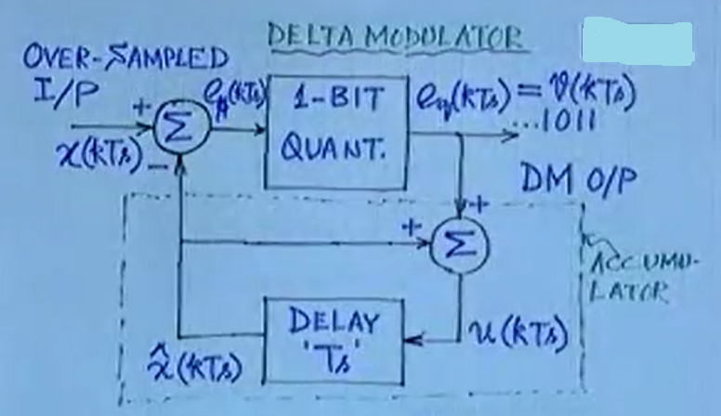
DM Block Diagram

Slide 18
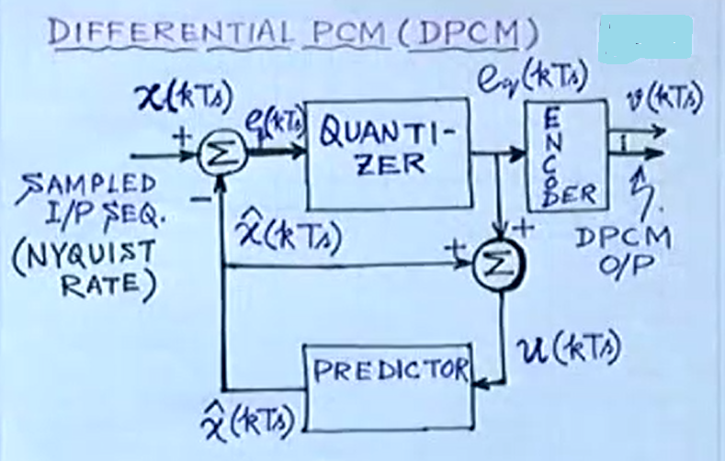
DPCM Block Diagram

Slide 19
Difference b/w B.D of DM & DPCM
Predictor is just a delay unit.
Quantizer is 1-bit quantizer
Its hardware implementation is just a comparator.
No encoder

Slide 20
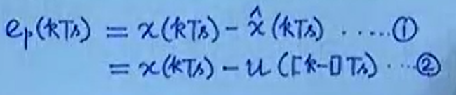
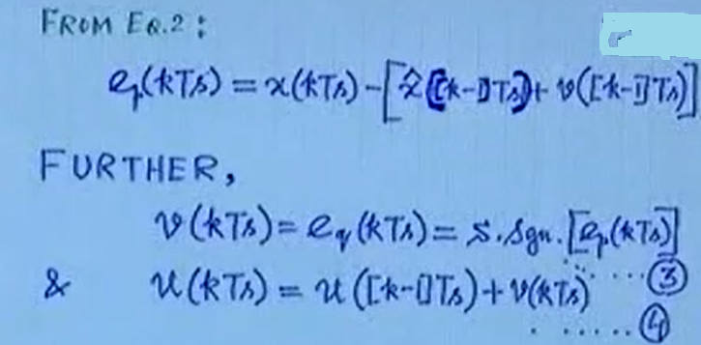
Analysis

Slide 21
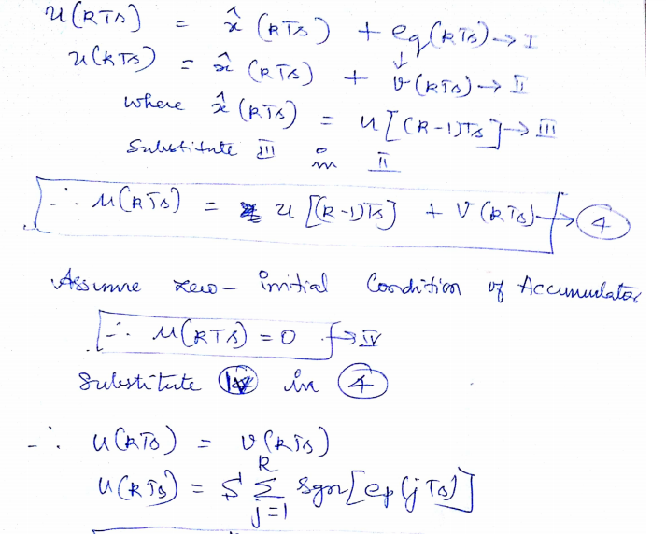


Slide 22
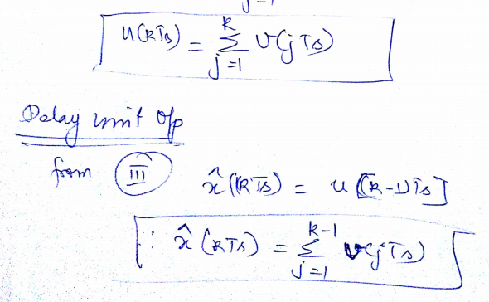

Slide 23
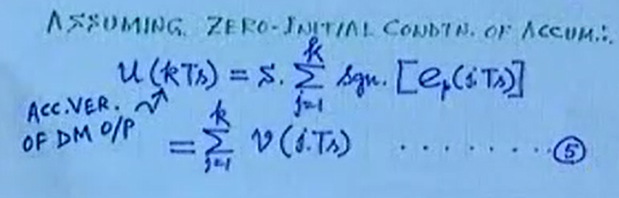
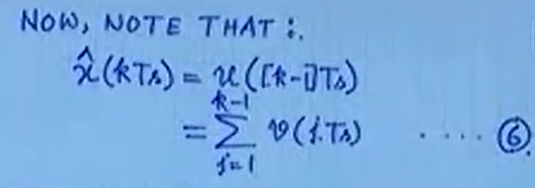
Cont..

Slide 24
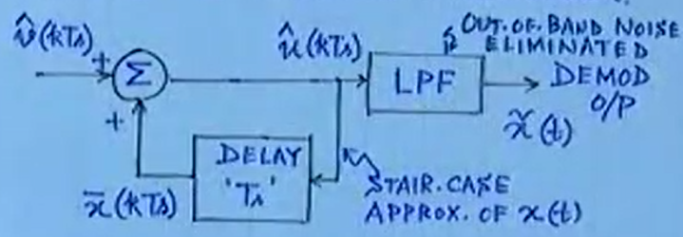
Demodulator Structure

Slide 25
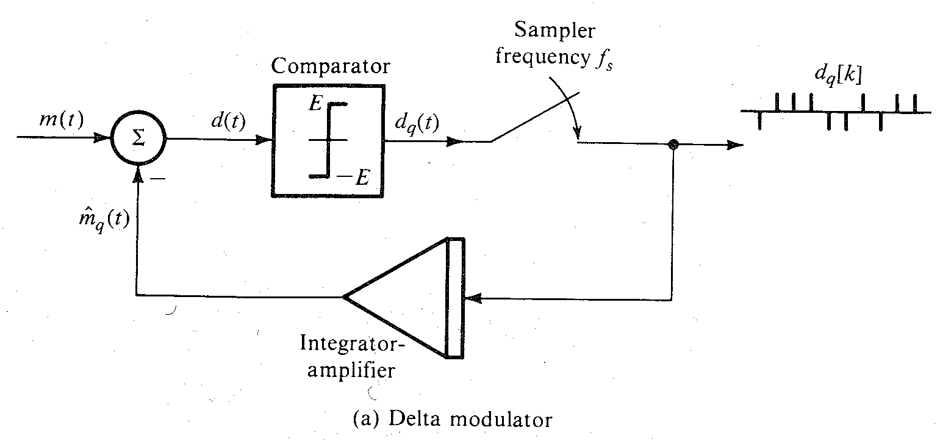
Practical Implementation

Slide 26
Practical Delta Modulator
1st order predictor is replaced by low cost integrator circuit (RC integrator).
Modulator consists of a comparator and a sampler in direct path.
An integrator-amplifier in feedback path.

Slide 27
Working
Analog signal is compared with feedback signal (which serves as a predicted signal).
Error signal is applied to a comparator.
If error signal is +ve, comparator output is constant signal of amplitude +S
If error signal is -ve, comparator output is constant signal of amplitude –S.
Thus, difference is a binary signal (L=2) that is needed to generate 1-bit DPCM.

Slide 28
Working
Comparator output is sampled by a sampler at a rate of fs samples per second.
Where fs is much higher than Nyquist rate.
Sampler thus produces a train of narrow pulses.
To simulate impulses with a +ve pulse when x(t)>xq^(t)
A –ve pulse when x(t)<xq^(t)

Slide 29
Working
Modulated signal is amplified and integrated in the feedback path to generate xq^(t) which tries to follow x(t).

Slide 30
Demodulator
Each pulse at the input of integrator gives rise to a step function
+ve or –ve depending on pulse polarity in x^(t)
For example, x(t)>xq^(t) a +ve pulse is generated which gives rise to a +ve step in xq^(t)
Trying to equalize xq^(t) to x(t) in small steps at every sampling instant.

Slide 31
Working
xq^(t) is a kind of staircase approximation of x(t).
When xq^(t) is passed through a LPF, coarseness of staircase in xq^(t) is eliminated
We get a smoother and better approximation to x(t).

Slide 32
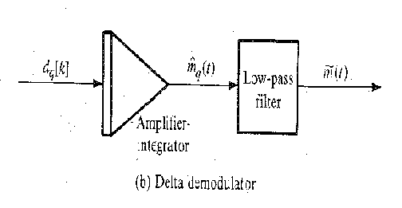
Practical Delta Demodulator

Slide 33
DM transmits the derivative of x(t)
PCM | DM
In PCM, analog samples are quantized in L levels | In DM, modulated signal carries information not about the signal samples but about the difference between successive samples.
Information is transmitted by ‘n’ pulses per sample (n=logL) | If the difference is +ve or –ve, a +ve or a –ve pulse is generated in modulated signal.
 | DM carries the information about the derivative of x(t) and hence the name delta modulation
 | This can also be seen that integration of delta-modulated signal yields x^(t), which is an approximation of x(t).

Slide 34
Cont…
PCM | DM
Information of each quantized sample is transmitted by n-bit code word. | Information of difference between successive samples is transmitted by 1-bit code word.

Slide 35
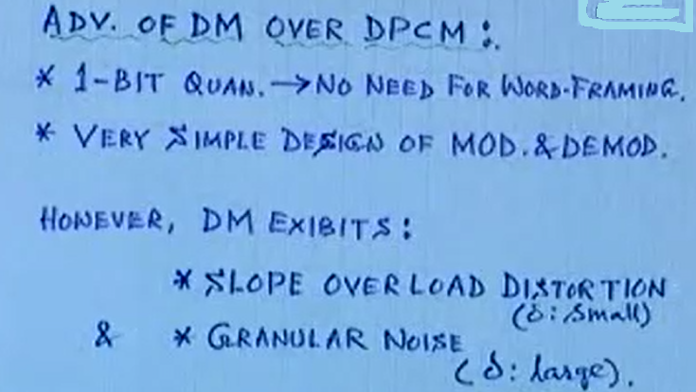
Merits & Demerits of DM

Slide 36
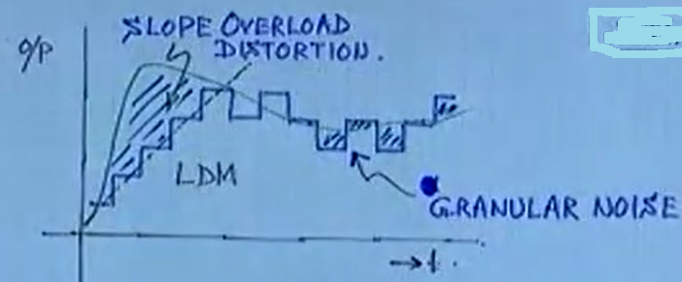
Demerits

Slide 37
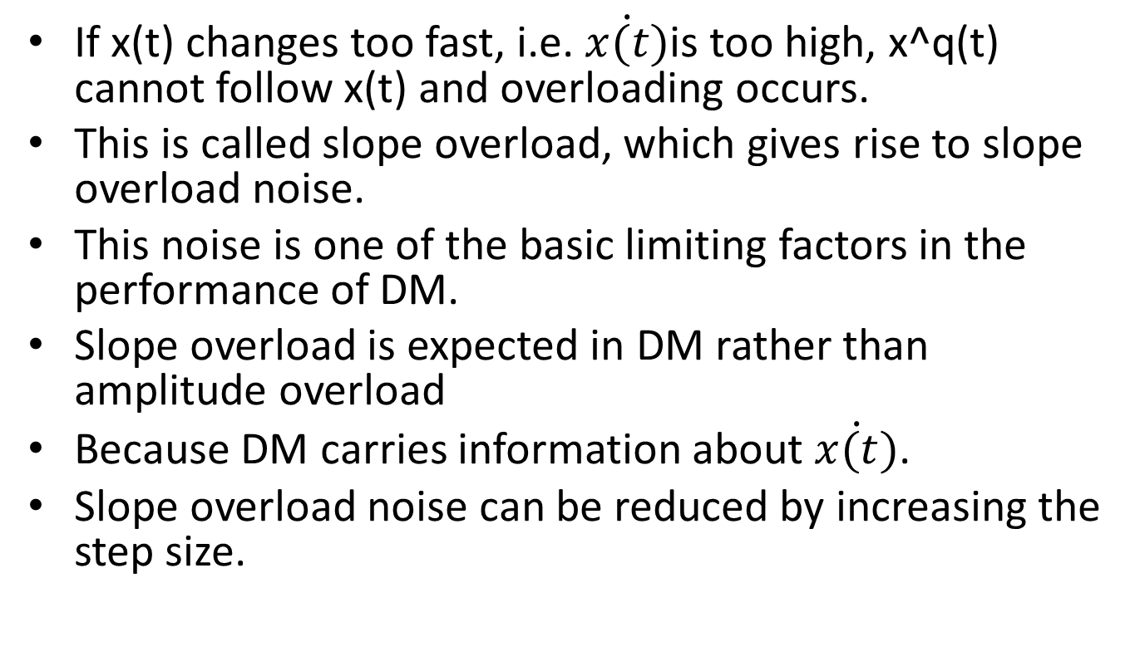
Slope overload
If x(t) changes too fast, i.e. $\dot{x(t)}$is too high, x^q(t) cannot follow x(t) and overloading occurs.
This is called slope overload, which gives rise to slope overload noise.
This noise is one of the basic limiting factors in the performance of DM.
Slope overload is expected in DM rather than amplitude overload
Because DM carries information about $\dot{x(t)}$.
Slope overload noise can be reduced by increasing the step size.

Slide 38
Granular noise
If the signal is not varying for long interval of time
Because of this feature of input signal with larger step size results in granular noise similar to quantization noise.
To reduce this effect step size should be decreased.

Slide 39
Linear DM
In the staircase approximation of signal, step size is increased when signal is increasing,
During that time slope remains constant,
So staircase approximates signal in a linear manner.
Hence DM is also called as Linear DM.

Slide 40
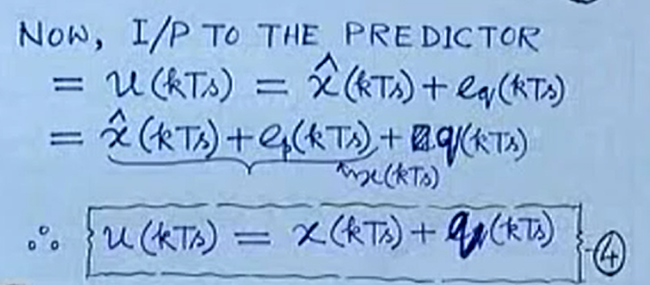
Condition to avoid Slope overload distortion in LDM

Slide 41
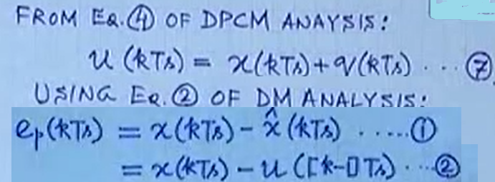
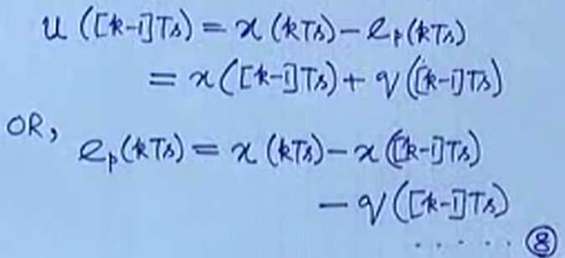
Cont..

Slide 42
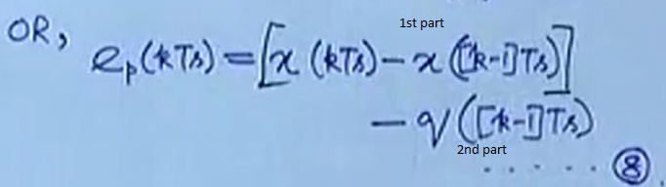
Cont..
Input to single step quantizer has 2 terms
Most recent i/p sample and previous quantization error
Quantization error can be made small by adjusting step size.

Slide 43
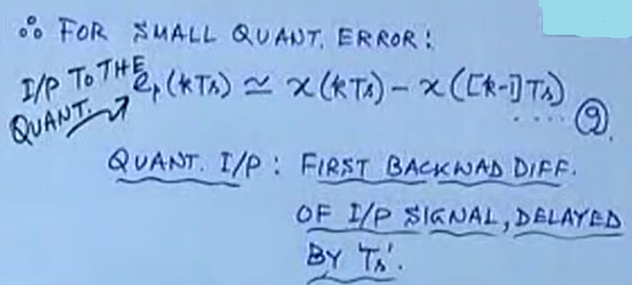
For small quantization error
In LDM, this observation is used for finding the condition for avoiding slope overload.

Slide 44
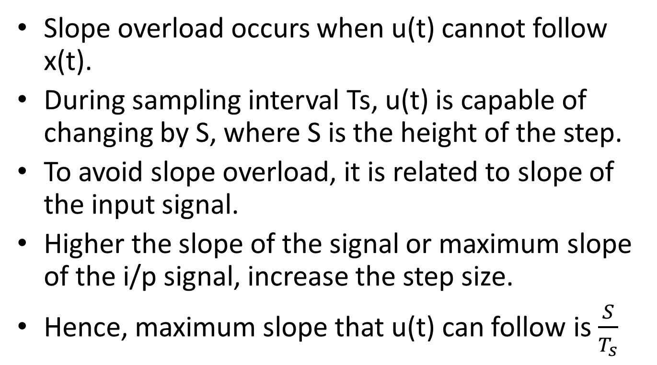
Condition to avoid Slope overload distortion in LDM
Slope overload occurs when u(t) cannot follow x(t).
During sampling interval Ts, u(t) is capable of changing by S, where S is the height of the step.
To avoid slope overload, it is related to slope of the input signal.
Higher the slope of the signal or maximum slope of the i/p signal, increase the step size.
Hence, maximum slope that u(t) can follow is $\frac{S}{T_{s}}$

Slide 45
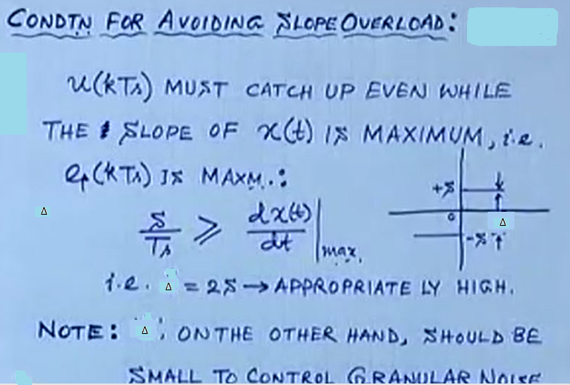
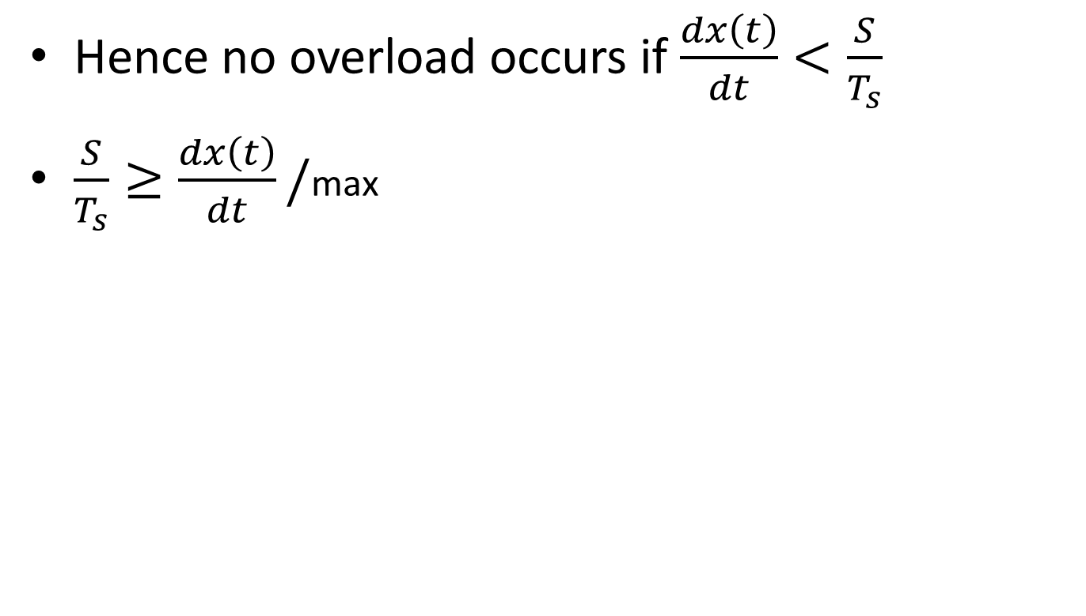
Cont..
Hence no overload occurs if $\frac{dx\left(t\right)}{dt}<\frac{S}{T_{s}}$
$\frac{S}{T_{s}}≥\frac{dx\left(t\right)}{dt}/$max

Slide 46
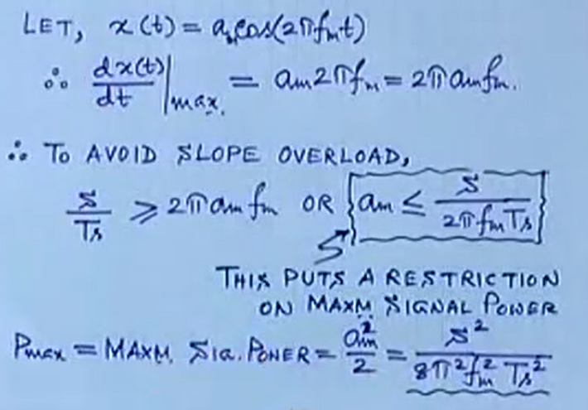
SQNR calculation for a single tone
Assume no slope overload problem

Slide 47
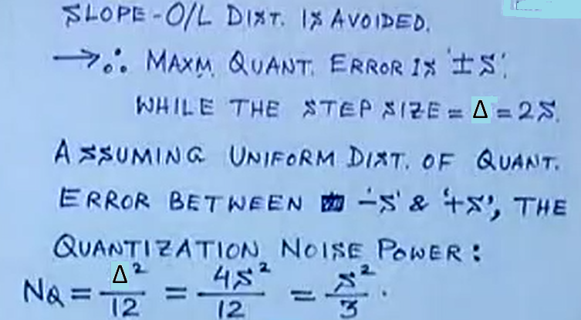
Cont..

Slide 48
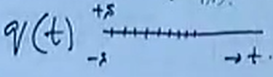
Cont..
NQ is not given totally to end user.
Quantization error will change very fast at fs=1/Ts between +S and –S.
For every Ts, q(t) changes between +S and –S very fastly.
Quantization noise occupies more bandwidth than i/p signal x(t).

Slide 49
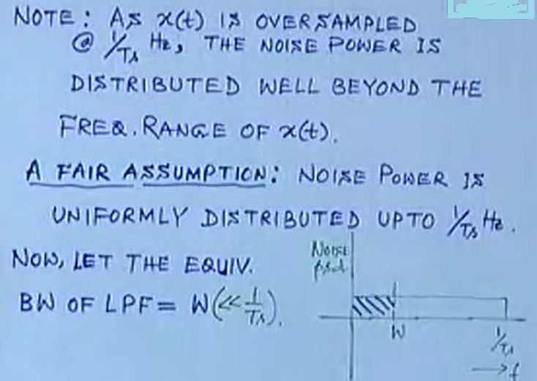
Cont..

Slide 50
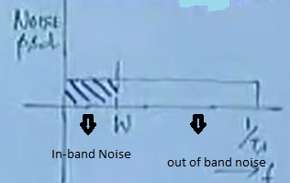
Cont…
Even though quantization noise power NQ stretched upto fs=1/Ts .
Effective noise power is fraction of it.N’Q.

Slide 51
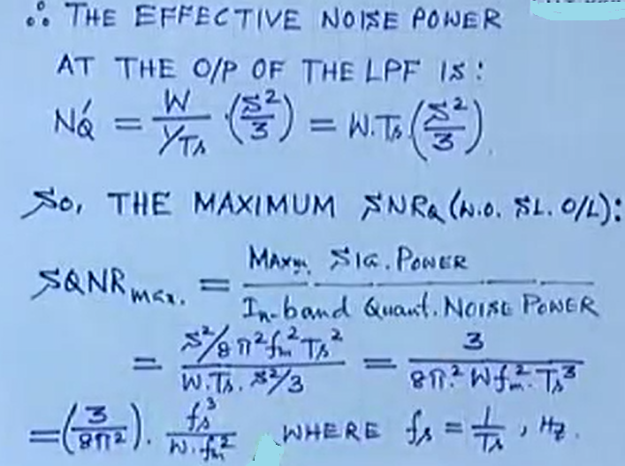
Cont..
K

Slide 52
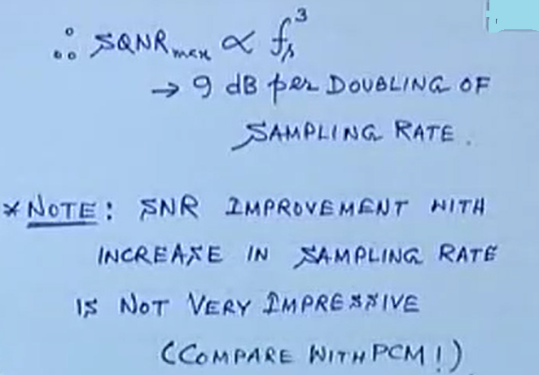
Conclusion

Slide 54
DM
In PCM, for speech signal 64Kbps bit rate is the standard one
For DPCM, for some specific example it may not need 8 bits/sample to achieve same SQNR
We can allocate 6 bits/sample or 4 bits/sample.
So overall bit rate after DPCM coding for speech signal is lower than 64Kbps.
It will be 48Kbps or 32Kbps.

Slide 55
Summary
In PCM, for each 1 bit increase, 6 dB SQNR improvement can be obtained.
For standard 8 bit PCM, Rs=8 Ksps, Rb=64Kbps, SQNR=48dB.
To have same SQNR of 48dB, from DM system sampling rate should not lower than 64
With ADM, able to achieve 40dB or more when 40 kbps or 48 kbps or 32 kbps.

Slide 56
Cont..
DM at rate of less than 24kbps i.e.16kbps is rarely accepted for limited applications but those are ADM.
For LDM acceptable SQNR around 40 dB and more is obtained if more than 48kbps.
At bit rate of 64kbps DM is not good and at this rate PCM is good
Because 6dB increase in SNR occurs in PCM for 1 bit increase
Whereas 9dB increase occurs for doubling fs in DM.

Slide 57
Cont..
DM works well 24kbps-48kbps
At higher rate PCM is better
At lower rate DPCM is better around 32kbps.

